Slide 1
Hypothesis Testing
Analysis of Biological Data
Chapter 6

Slide 2
Key Learning Objectives
Be able to describe the Null Hypothesis.
Understand the practice of Null Hypothesis Significance Testing.
Master the meaning of a P-Value.
Explain the concepts of false positives and false negatives and why they happen.

Slide 3
Intro to Hypothesis Testing
In addition to estimation, hypothesis testing is a major goal of statistics.
Example Hypotheses:
Does a treatment have an effect?
Are two groups different?
Do the number of problems grow with a persons income?

Slide 4
Hypothesis Testing: The Dilemma 🤔
We want to know about the World Out There.
We cannot sample the entire population.
We can take a sample and make estimates.
Samples differ from populations by chance.
So, can an estimate be simply explained by chance, or is it special?

Slide 5
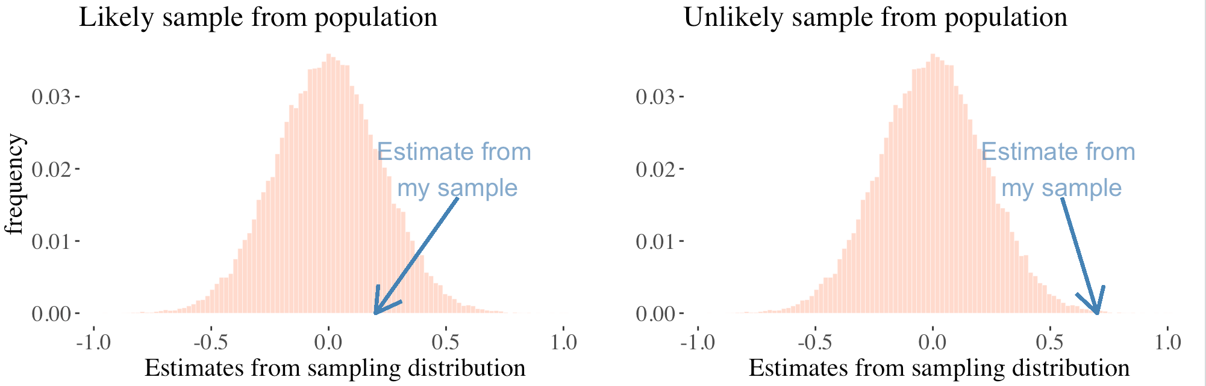
Hypothesis Testing: The Solution 🧐
In practice we take a sample & make an estimate.
In stats theory, we imagine an infinite number of samples from a population, building a sampling distribution & finding where our sample would fall.

Slide 6
⚠️ Critical Assumption ⚠️
Hypothesis testing assumes random sampling
Or that we account for non-random sampling in the null model.
Hypothesis tests account for sampling error, NOT for sampling bias.
Hypothesis tests from 💩 biased samples 💩
are misleading and cannot be trusted.

Slide 7
What’s the deal with the 😒 Null Hypothesis 😒 ⁉️

Slide 8
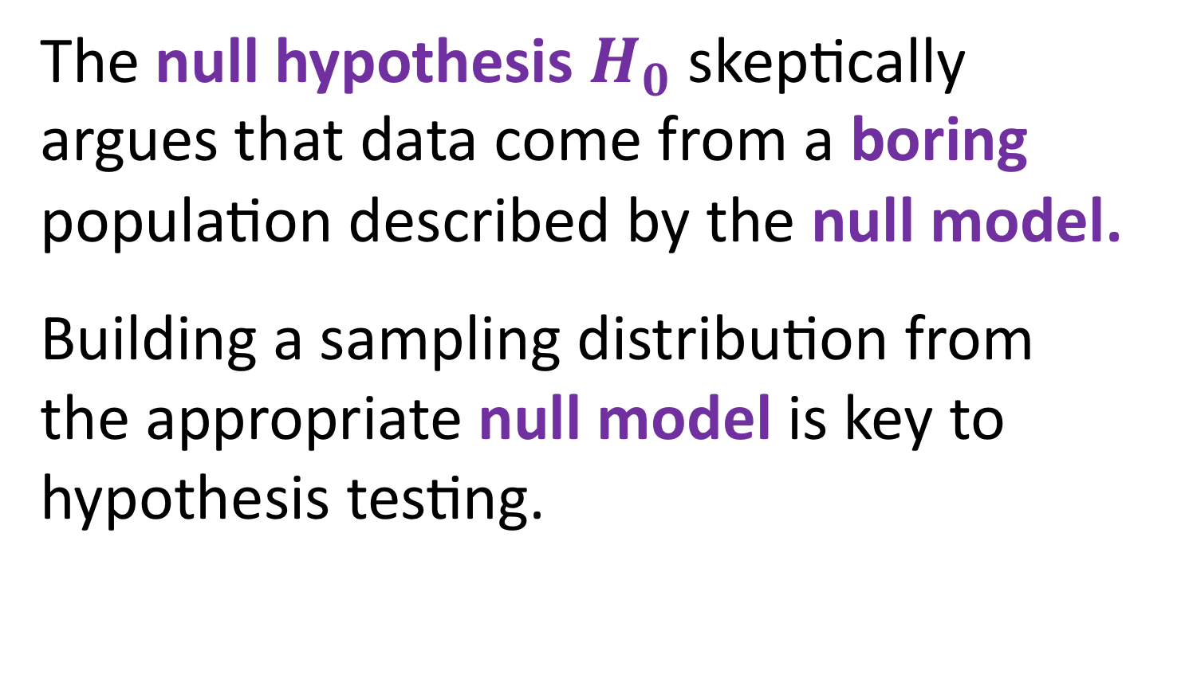
The Boring Population
The null hypothesis $H_{0}$ skeptically argues that data come from a boring population described by the null model.
Building a sampling distribution from the appropriate null model is key to hypothesis testing.

Slide 9
Hypotheses Are About Populations
We conduct hypothesis testing by checking if our estimate is surprising under the null model.
We ask, "Is the population from which we sampled different from a boring population"

Slide 10
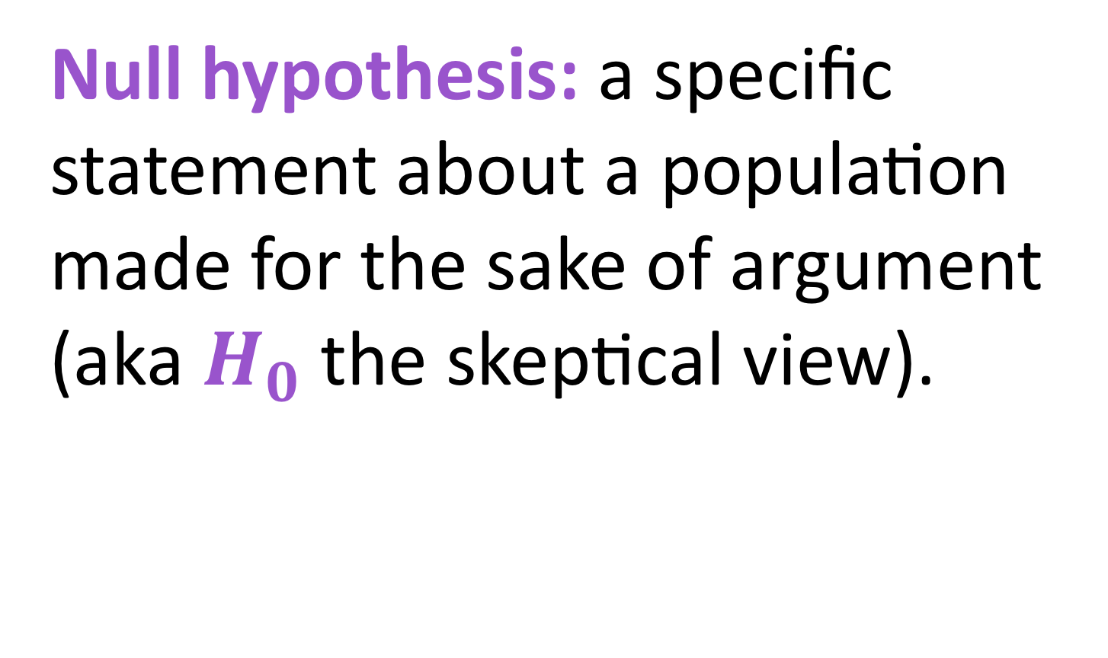
The Null hypothesis
Null hypothesis: a specific statement about a population made for the sake of argument (aka $H_{0}$the skeptical view).

Slide 11
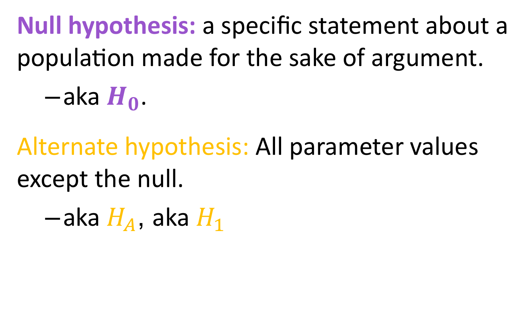
Null vs. Alternate hypothesis
Null hypothesis: a specific statement about a population made for the sake of argument.
aka $H_{0}$.
Alternate hypothesis: All parameter values except the null.
aka $H_{A}$, aka $H_{1}$

Slide 12
Remember Why We Do Stats!
Our goal is to learn about the World Out There (the population) from our finite view (the sample).
Rejecting the H₀ is not our goal
(but it can be satisfying / exciting).

Slide 13
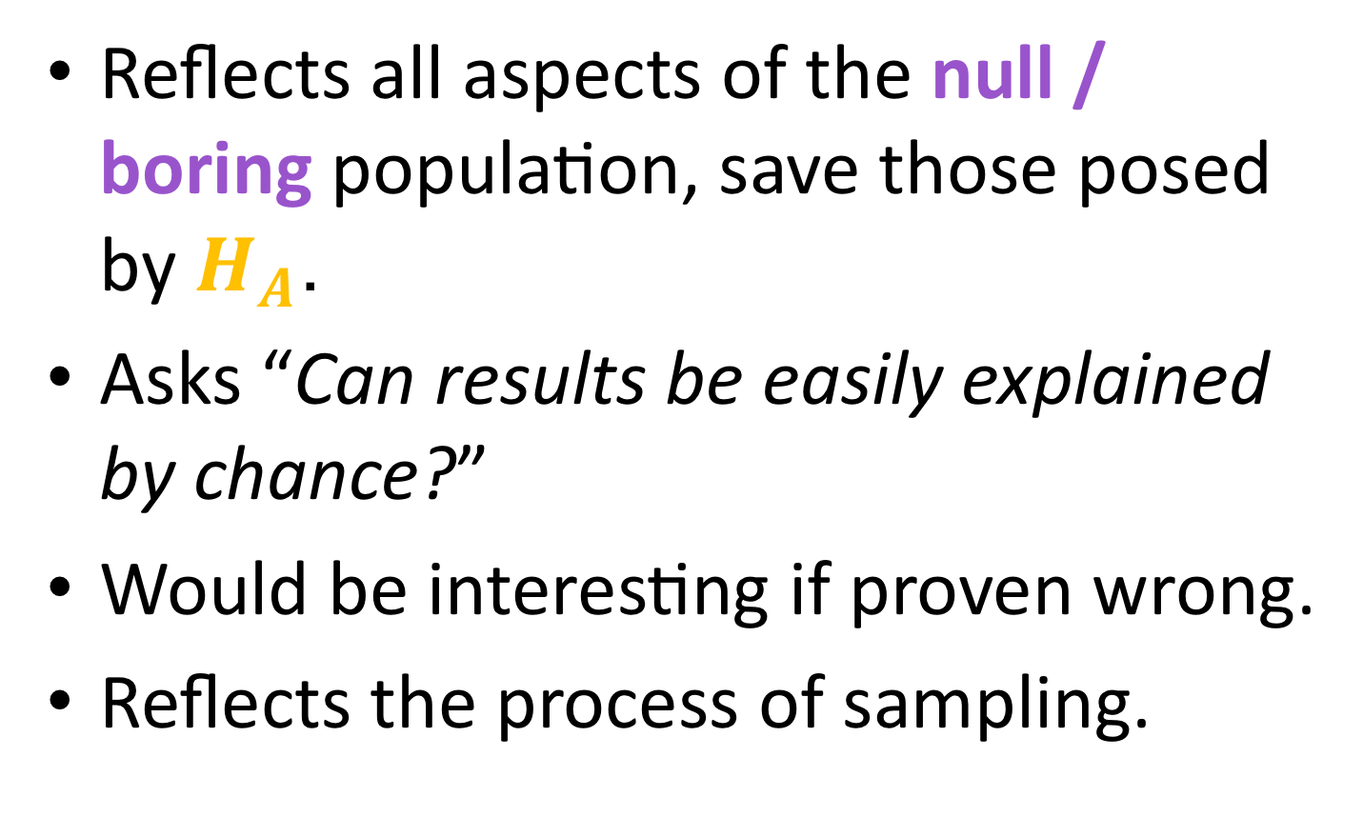
A Good Null Hypothesis:
Reflects all aspects of the null / boring population, save those posed by $H_{A}$.
Asks “Can results be easily explained by chance?”
Would be interesting if proven wrong.
Reflects the process of sampling.

Slide 14

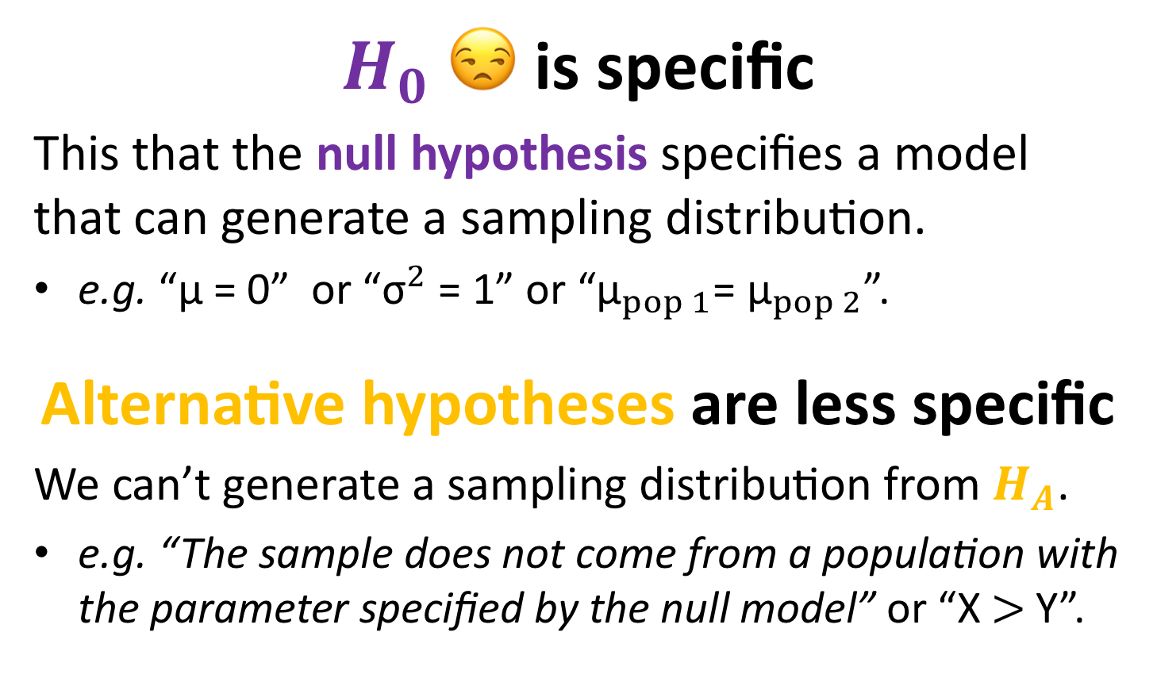
😒 $H_{0}$ 😒 is specific, 🤓 $H_{A}$🤓 is not.
$H_{0}$ 😒 is specific
This that the null hypothesis specifies a model that can generate a sampling distribution.
e.g. “μ = 0” or “${\text{σ}}^{2}$ = 1” or “${\text{μ}}_{pop 1}$= ${\text{μ}}_{pop 2}$”.
Alternative hypotheses are less specific
We can’t generate a sampling distribution from $H_{A}$.
e.g. “The sample does not come from a population with the parameter specified by the null model” or “X$>$Y”.

Slide 15

Why Do We Test $H_{0}$?
Heck, my eight grade science class managed to conclusively rejected it just based on a classroom experiment. It’s pretty sad to hear about million-dollar research teams who can’t even manage that. https://xkcd.com/892/

Slide 16
The P-value 😲 A measure of surprise 😲

Slide 17
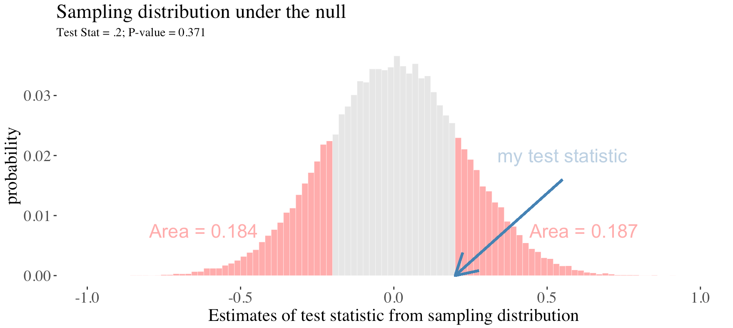
P-Value
The p-value is the probability a sample from the null model would be as or more extreme than our sample.

Slide 18
Finding P-values
Evaluating where the test statistic lies on a sampling distribution built from the null model.
We generate this null sampling distribution by:
Simulation
Permutation (shuffling)
Mathematical results developed by professional statisticians. These are built from the logic of probability theory.

Slide 19
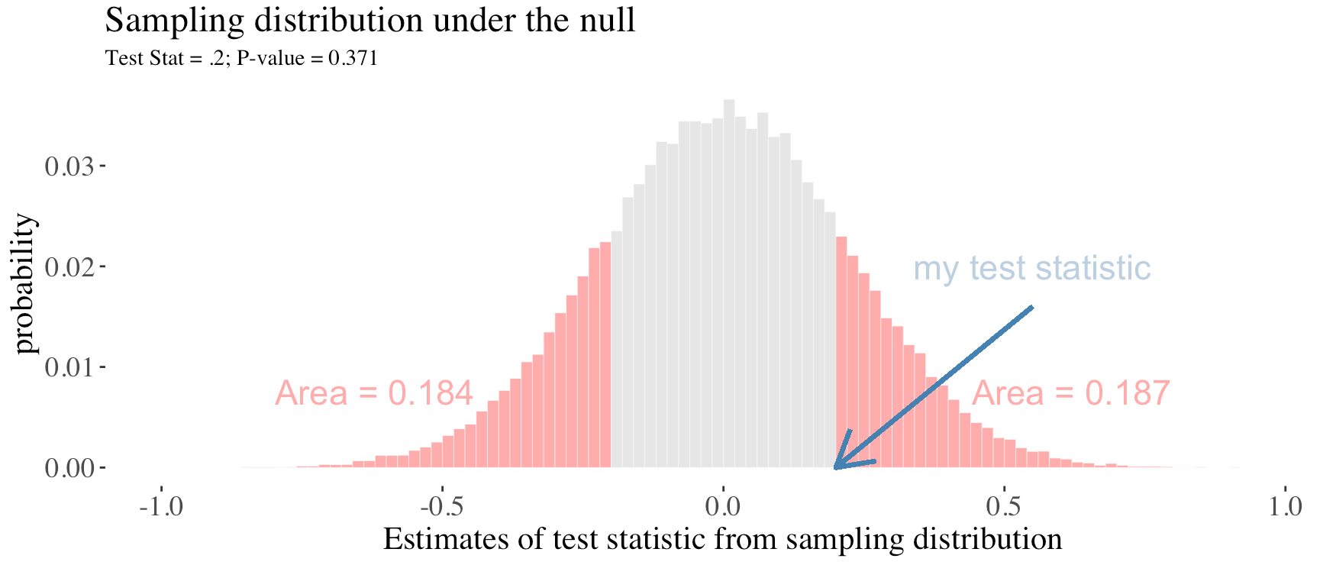
An Unremarkable P-Value
We would 😴 not be surprised 😴 if the sample below came from the null model.

Slide 20
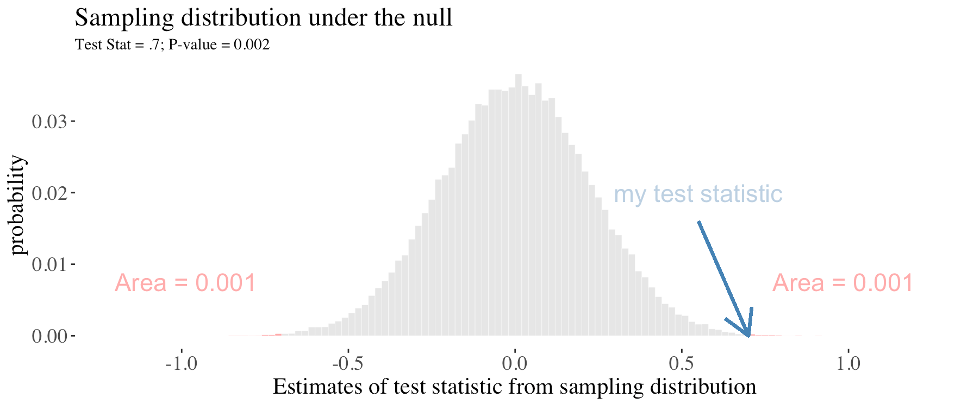
A Remarkable P-Value
We would be 😲 very surprised😲 if the sample below came from the null model.

Slide 21
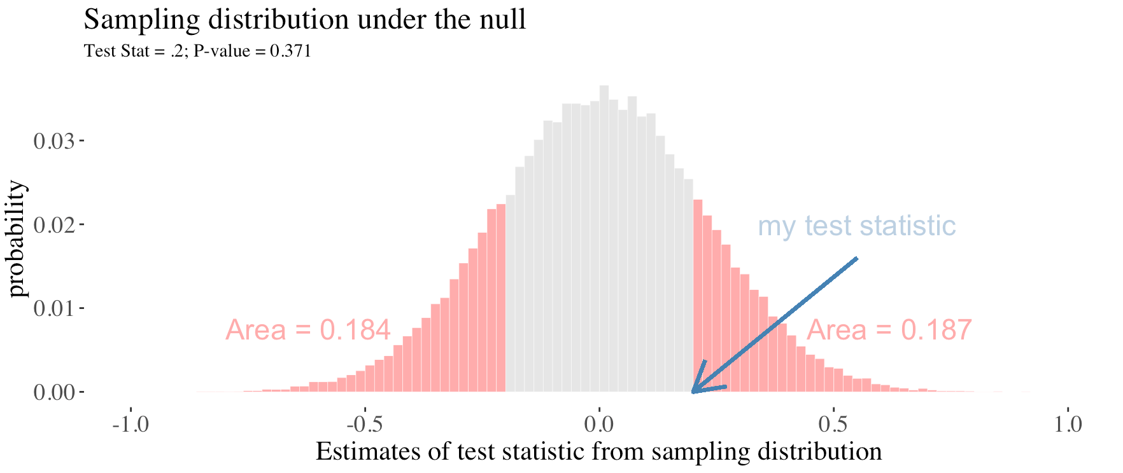
Most Tests Are Two-Tailed
This means that a deviation in either tail of the distribution would be worth reporting.

Slide 22
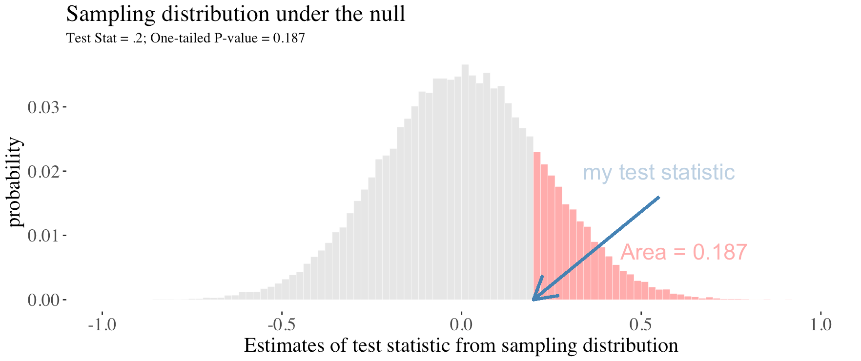
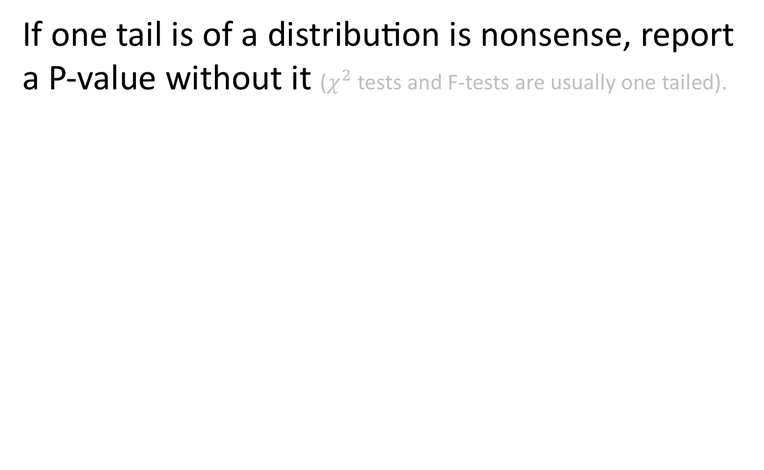
One Tailed P-Values
If one tail is of a distribution is nonsense, report a P-value without it ($χ^{2}$ tests and F-tests are usually one tailed).

Slide 23
A Guide to P-Values (From The ASA)
P-values can indicate how incompatible the data are with a specified model.
P-values DO NOT measure the probability that a hypothesis is true.
Conclusions / decisions should not be based only on whether a p-value passes a specific threshold.
Valid inference requires full reporting & transparency.
P-values DO NOT measure the size of an effect or the importance of a result.

Slide 24
Statistical Significance and
Making Binary Decisions

Slide 25
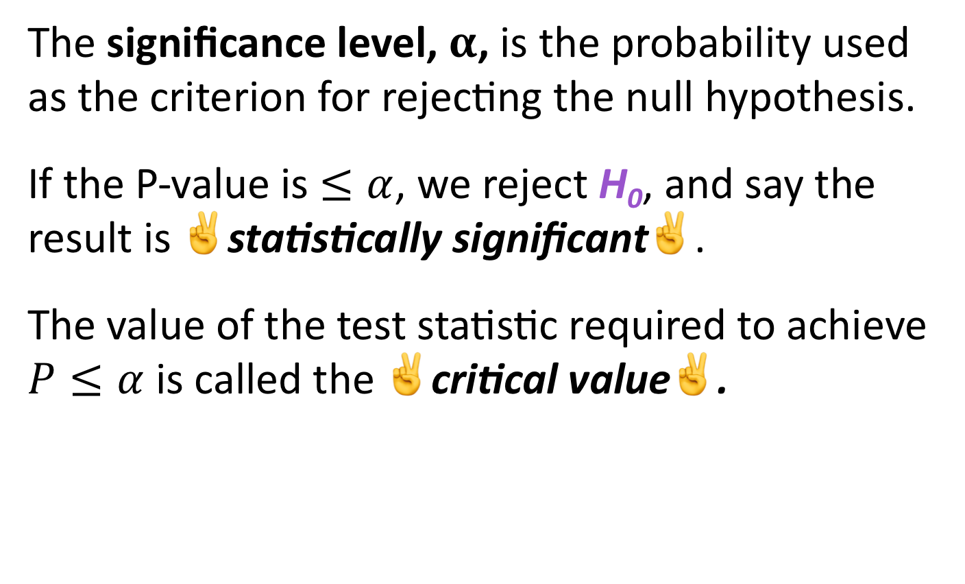
Statistical Significance
The significance level, $α$, is the probability used as the criterion for rejecting the null hypothesis.
If the P-value is $≤α$, we reject H₀, and say the result is ✌️statistically significant✌️.
The value of the test statistic required to achieve $P≤α$ is called the ✌️critical value✌️.

Slide 26
Stop 🛑 Think 🧠 What Happened❓
As skeptical scientists, we set up a boring null hypothesis (H₀).
We don’t test if H₀ is true or false. Rather, we ask, “How weird would it be to get a value as weird (or weirder) than mine if the null was true.”
If the answer is “Pretty weird,” we ✌️reject H₀✌️.

Slide 27

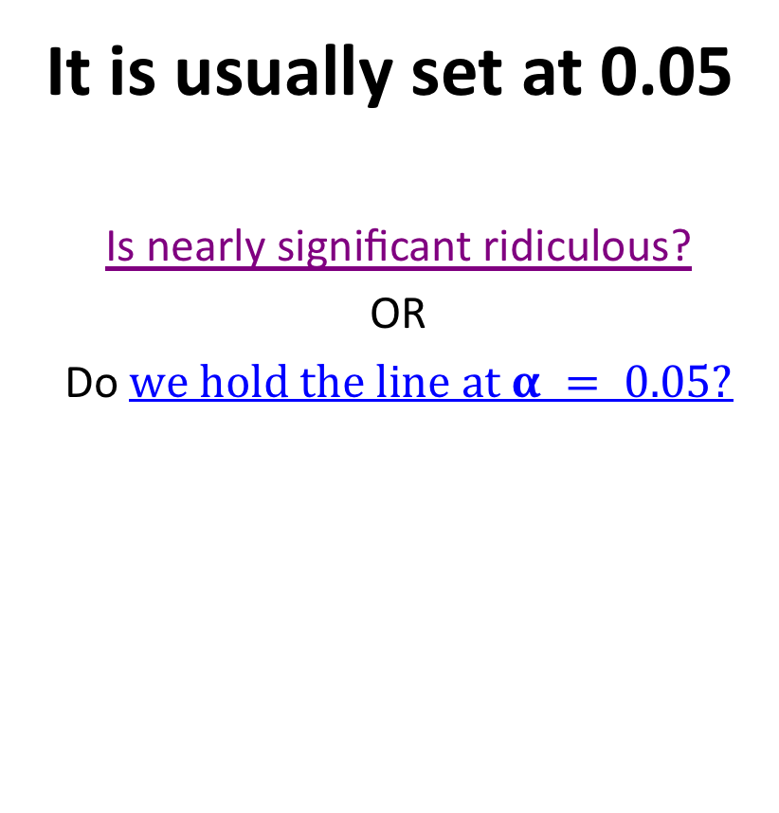
Is $α$ (Somewhat) Arbitrary?
It is usually set at 0.05
Is nearly significant ridiculous?
OR
Do $we hold the line at α = 0.05?$
“If all else fails use significance at the $α$ = 0.05 level and hope no one notices” https://xkcd.com/1478/

Slide 28

Why is often $α$ = 0.05 ?
“The value for which P=0.05, or 1 in 20 … is convenient to take this point as a limit in judging whether a deviation ought to be considered significant or not…”
“If one in twenty does not seem high enough odds, we may … draw the line at one in fifty …, or one in a hundred…. Personally, the writer prefers to set a low standard of significance at the 5 per cent point, and ignore entirely all results which fail to reach this level.”
~ R.A Fisher

Slide 29
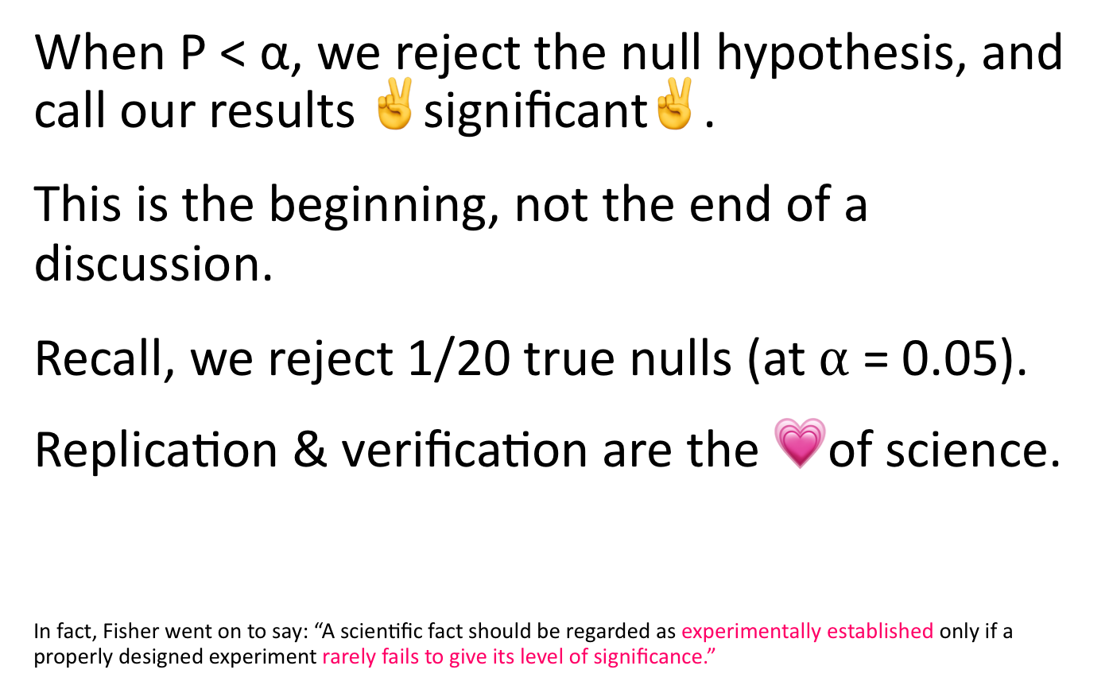
What To Do When P < α?
When P < α, we reject the null hypothesis, and call our results ✌️significant✌️.
This is the beginning, not the end of a discussion.
Recall, we reject 1/20 true nulls (at $α$ = 0.05).
Replication & verification are the 💗of science.
In fact, Fisher went on to say: “A scientific fact should be regarded as experimentally established only if a properly designed experiment rarely fails to give its level of significance.”

Slide 30

What To Do When P $>$ $α$?
🚨We can never accept the null🚨
If the test statistic does not meet the critical value, we fail to reject the null hypothesis.

Slide 31
Errors in Hypothesis Testing

Slide 32
Hypothesis Testing: What Could Go Wrong?
Even if you do everything right, hypothesis testing can get it wrong.
Hypothesis testing can go wrong in two types of ways:
Rejecting a true null (False positive).
Not rejecting a false null (False negative).

Slide 33
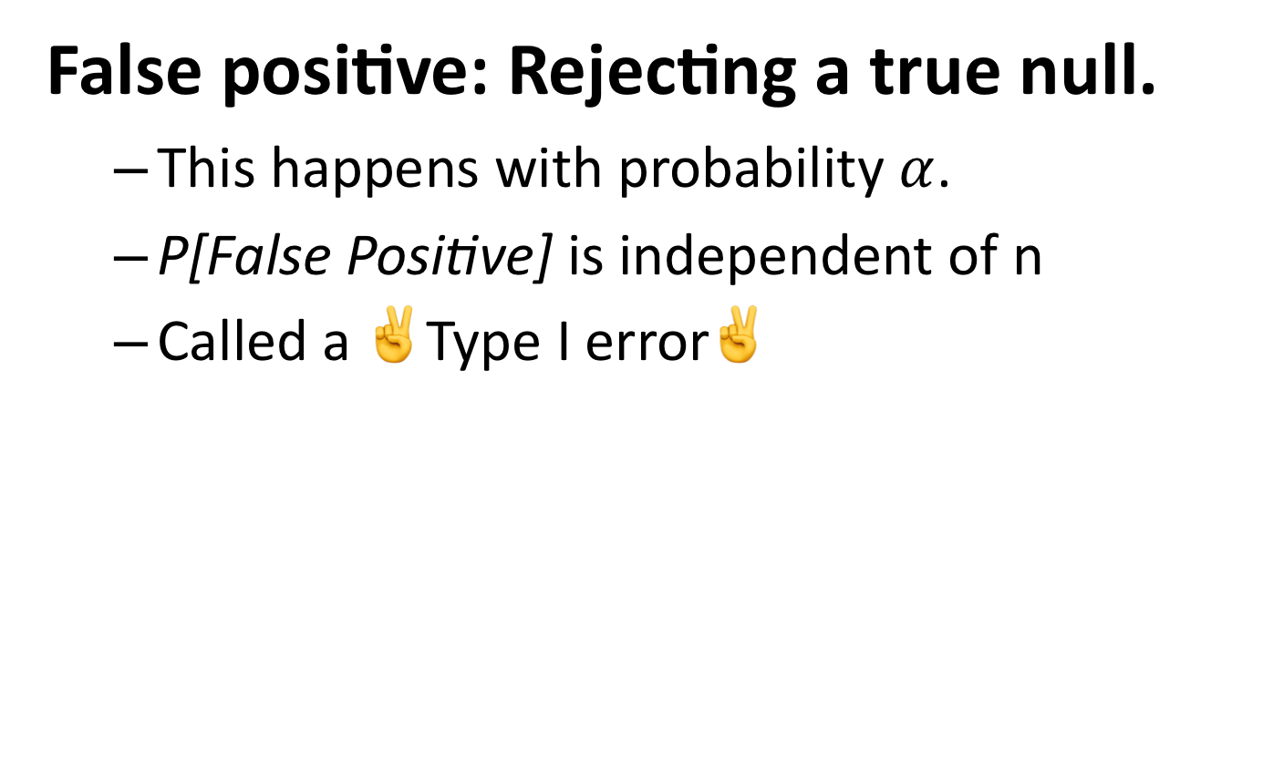
A False Positive
False positive: Rejecting a true null.
This happens with probability $α$.
P[False Positive] is independent of n
Called a ✌️Type I error✌️

Slide 34
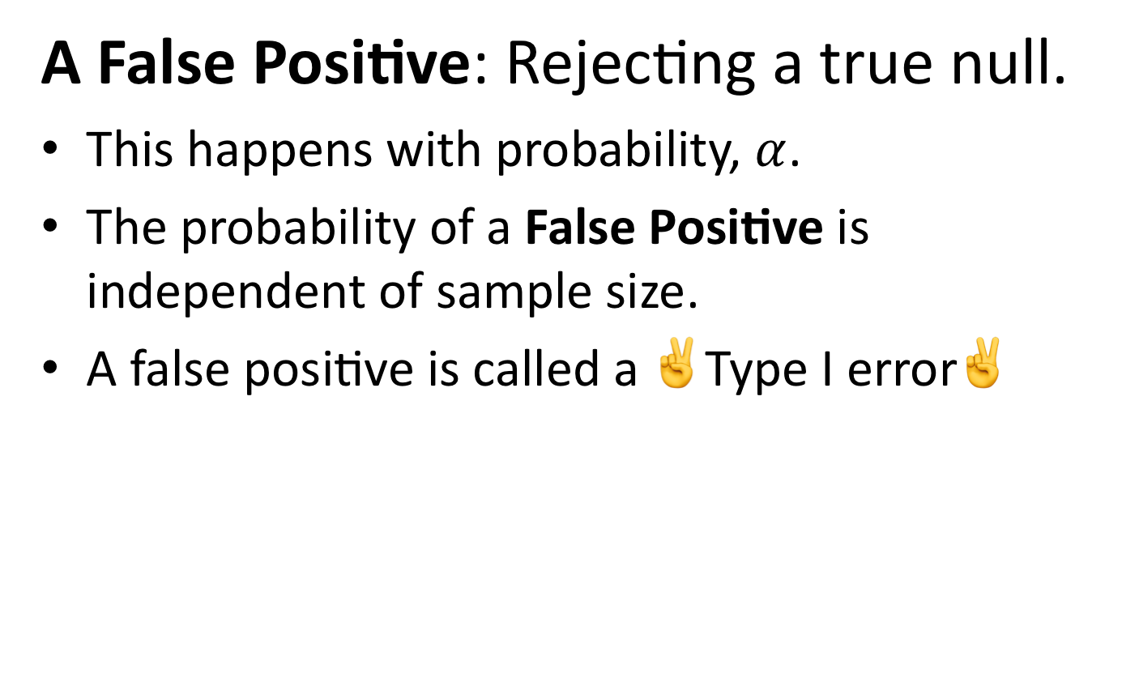
A False Negative
A False Positive: Rejecting a true null.
This happens with probability, $α$.
The probability of a False Positive is independent of sample size.
A false positive is called a ✌️Type I error✌️

Slide 35
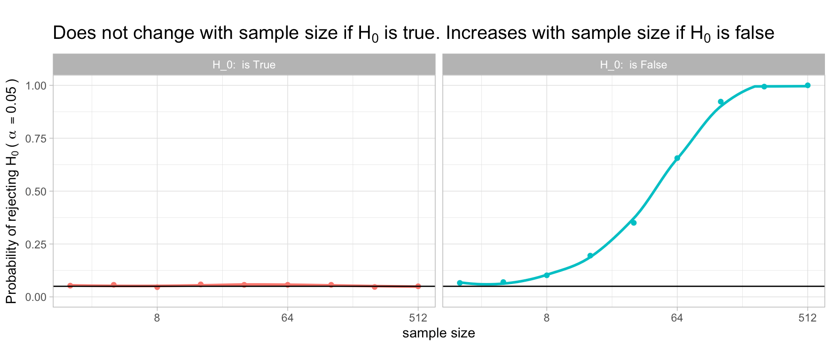
Effects of Sample Size
The probability of rejecting H₀:
*The exact relationship between sample size and the probability of rejecting a false null depends on the effect size and the variance.

Slide 36
Hypothesis Testing Example: Red vs Blue Wrestlers

Slide 37
Hypothesis Testing Example
Does wearing a red shirt help win a wrestling match?
https://commons.wikimedia.org/wiki/Category:Freestyle_wrestling#/media/File:DF-SD-01-07078.jpg

Slide 38
The Experiment and Results
Does red influence the outcome of wrestling, taekwondo, and boxing?
Data / experiment
16 of 20 round has more red-shirted than blue-shirted winners in in the 2004 Olympics.
Shirt color was randomly assigned.
Potentially related to red as a sign of aggression in animals.

Slide 39
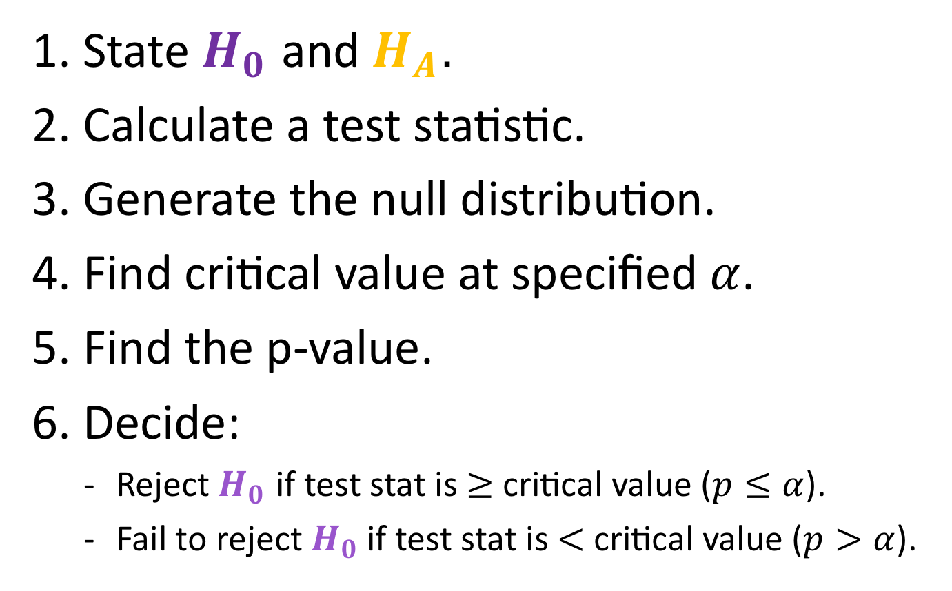
Steps of Hypothesis Testing
State $H_{0}$ and $H_{A}$.
Calculate a test statistic.
Generate the null distribution.
Find critical value at specified $α$.
Find the p-value.
Decide:
Reject $H_{0}$ if test stat is $≥$ critical value ($p≤α$).
Fail to reject $H_{0}$if test stat is $<$ critical value ($p>α$).

Slide 40

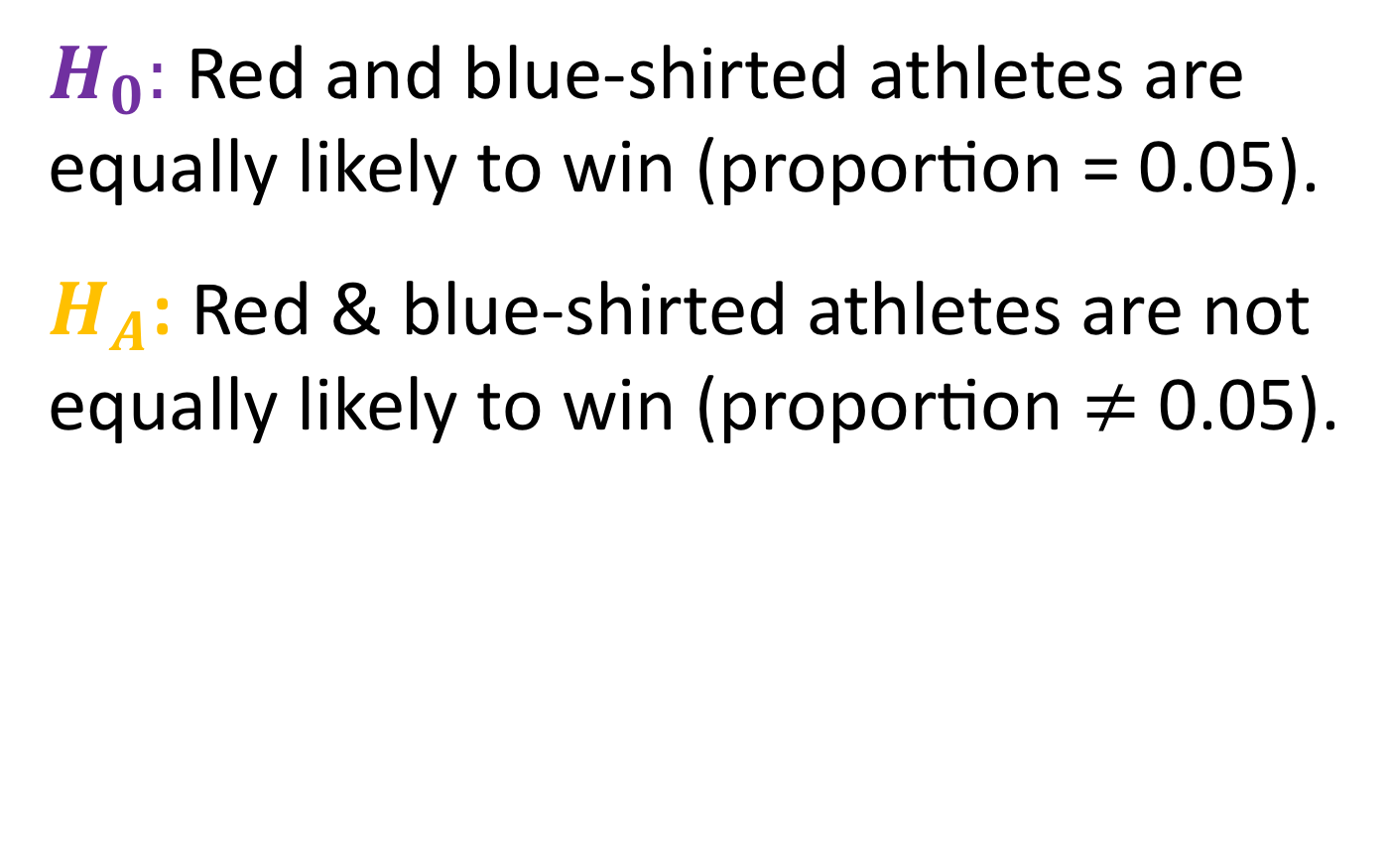
1. State $H_{0}$ and $H_{A}$
$H_{0}:$Red and blue-shirted athletes are equally likely to win (proportion = 0.05).
$H_{A}$: Red & blue-shirted athletes are not equally likely to win (proportion $≠$ 0.05).

Slide 41
2. Calculate a Test Statistic.
16 of 20 rounds had more red-shirted than blue-shirted winners.
Test stat is the difference between our observation (16 of 20 wins) and our expectation (10 of twenty wins).

Slide 42
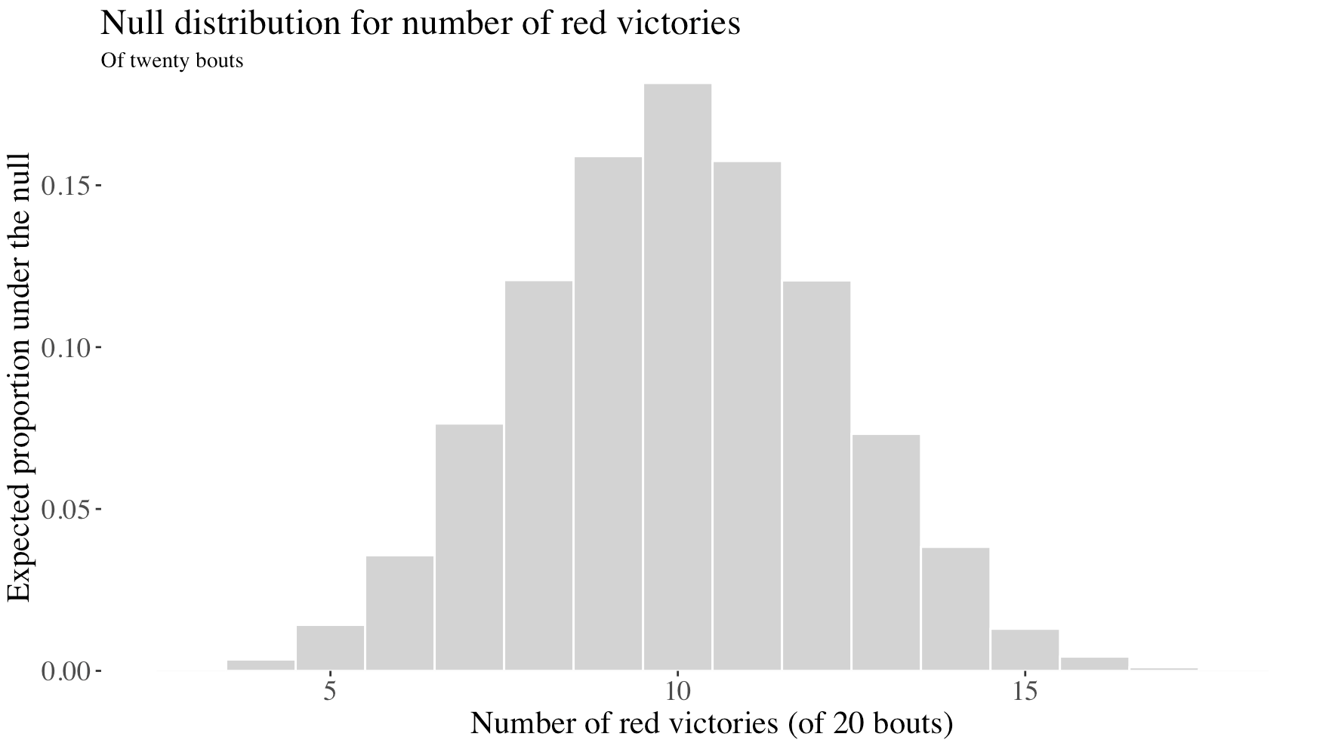
3. Generate the Null Distribution.

Slide 43
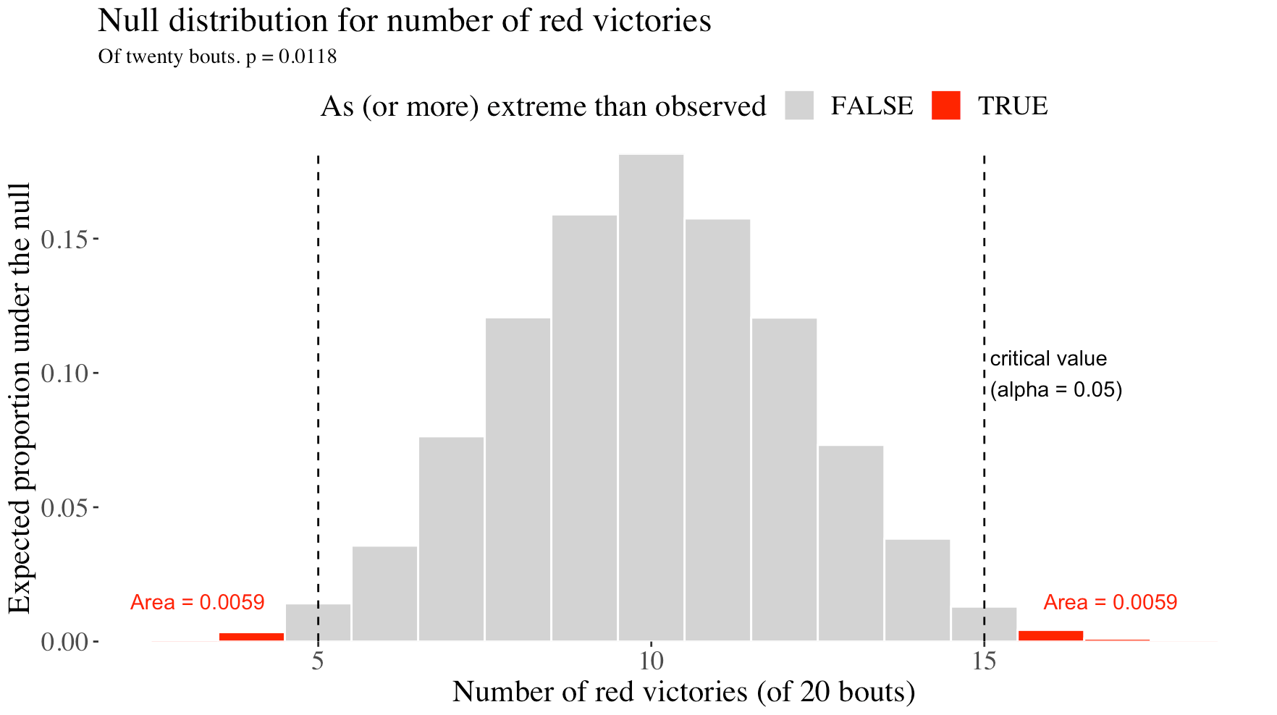
4 & 5: Find the critical Value & P-Value.

Slide 44
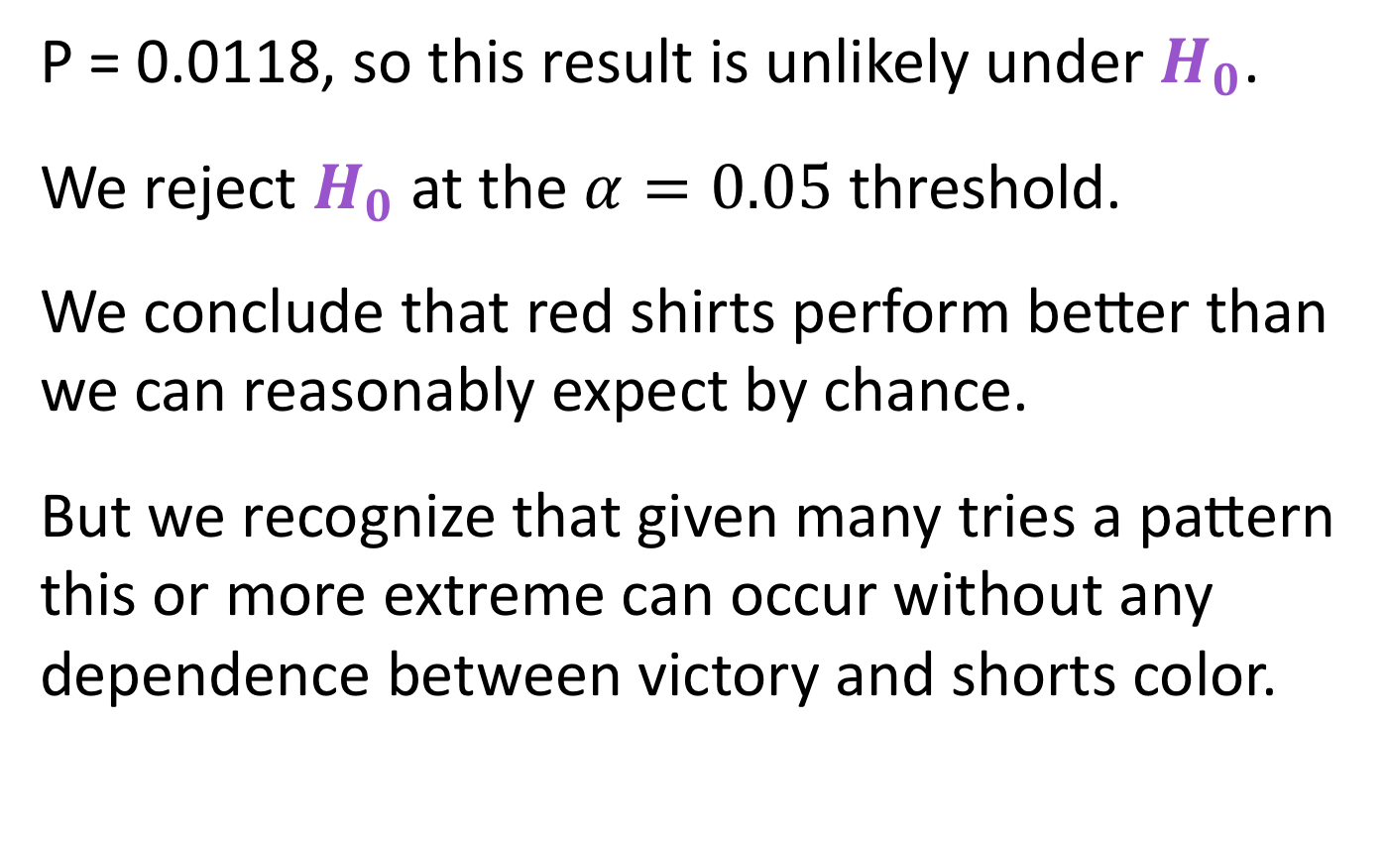
6. Decide and Conclude
P = 0.0118, so this result is unlikely under $H_{0}$.
We reject $H_{0}$at the $α=0.05$ threshold.
We conclude that red shirts perform better than we can reasonably expect by chance.
But we recognize that given many tries a pattern this or more extreme can occur without any dependence between victory and shorts color.

Slide 45
Hypothesis Testing: Caveats and Cautionary Tales

Slide 46
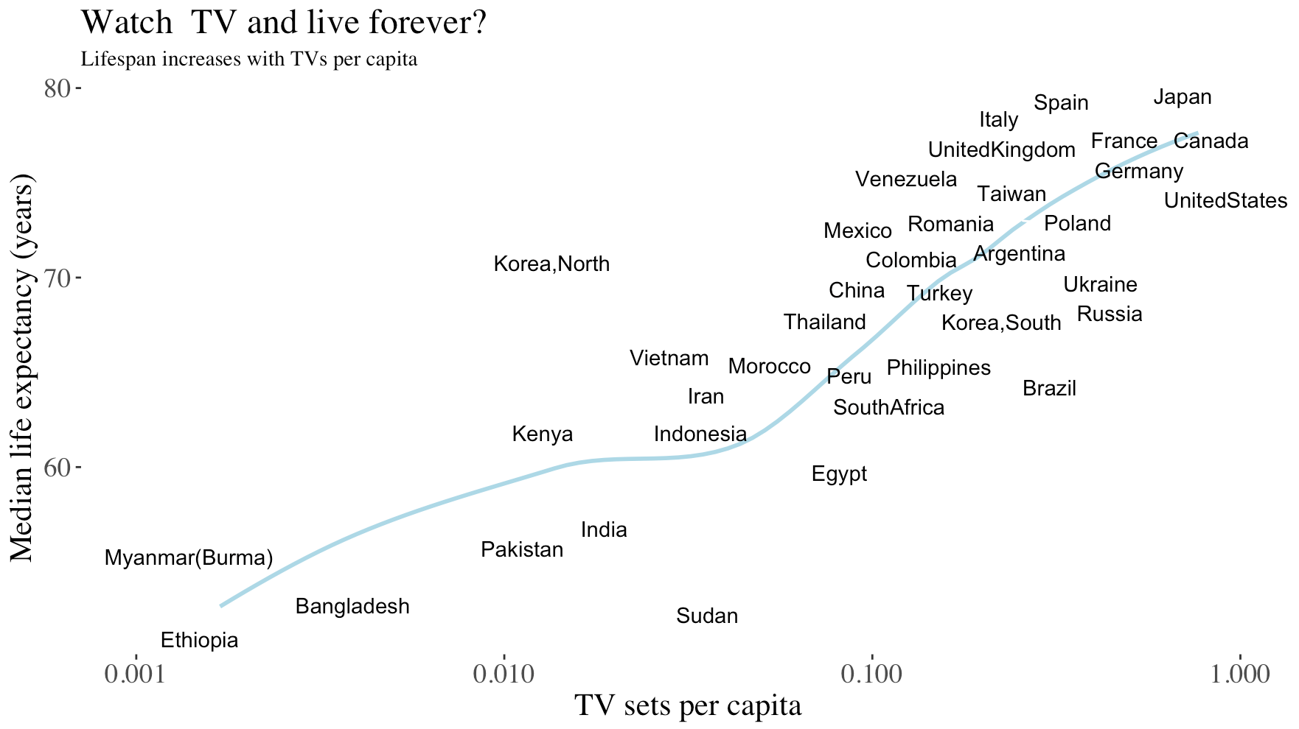
Correlation Does Not Equal Causation

Slide 47
Confounding Variable
A confounding variable is an unmeasured variable that may cause both X and Y.
Revisit the association between lifespan and TV sets per capita, try to think of a confound.

Slide 48
Observations vs Experiments
Observed correlations are intriguing, and can generate a plausible and important hypotheses.
Correlations in treatment (X) and outcome (Y) in well-controlled experimental manipulations more strongly imply causation because we can (try to) control for confounding variables.

Slide 49

Significance $≠$ Importance
Example: High powered Genome Wide Association Studies (GWAS) often identify loci associated with negligible increases in the chance of acquiring some disease.
https://www.smbc-comics.com/comic/the-satan-gene

Slide 50
Test Meaningful Hypotheses!
🛩 No evidence that parachutes prevent death and major trauma when jumping from an aircraft.🛩
Yeh et al. 2018. BMJ

Slide 51
Hypothesis Testing Summary

Slide 52
Key Points
We test hypotheses about populations from sample estimates.
A P-Value is the probability that a boring population would generate a sample estimate as or more extreme than we observe.
We reject the null hypothesis when this probability is low & fail to reject it otherwise.
Hypothesis testing can go wrong: We can reject true nulls and fail to reject false ones.
Hypothesis testing requires extreme care.

